Slide 1
Less Distracted Siam-RPN
Mudit Garg
Vijay Vamsi Nadella
Arun Teja Muluka

Slide 2
Motivation and Proposal
Problem Statement: Siam-RPN gets distracted when similar objects are present in the frame and the object to be tracked has gone close the distractor.
Solution: We applied mean-shift algorithm and plan to use feature space engineering to extend Siamese-RPN in order to help the tracker get less distracted comparatively.
Why this method? :
Mean-shift always finds a local mode in every frame, thus, finding the dominant object.
Architecture:
Mean-shift algorithm is applied on the feature map generated by the regression branch of Siam-RPN.

Slide 3
Discussion & Related Work
Various trackers like DaSiamRPM and Siamese C-RPN have been proposed to overcome distractor issue in SiamRPN.
All the above models had impacted performance of SiamRPN, thereby negating its performance benefit.
We have chosen mean-shift as it is not computationally expensive, thereby not affecting the performance of SiamRPN significantly.
Our plan is to avoid the distractors without having huge impact on the speed of SiamRPN.

Slide 4
Details: Tracker & Datasets
The base tracker we are using is SiamRPN which is trained on datasets: VID, YoutubeBB, COCO, ImageNetDet.
After the implementation of proposed algorithm, we will evaluate our model on datasets VOT-17 and VOT-18.

Slide 5
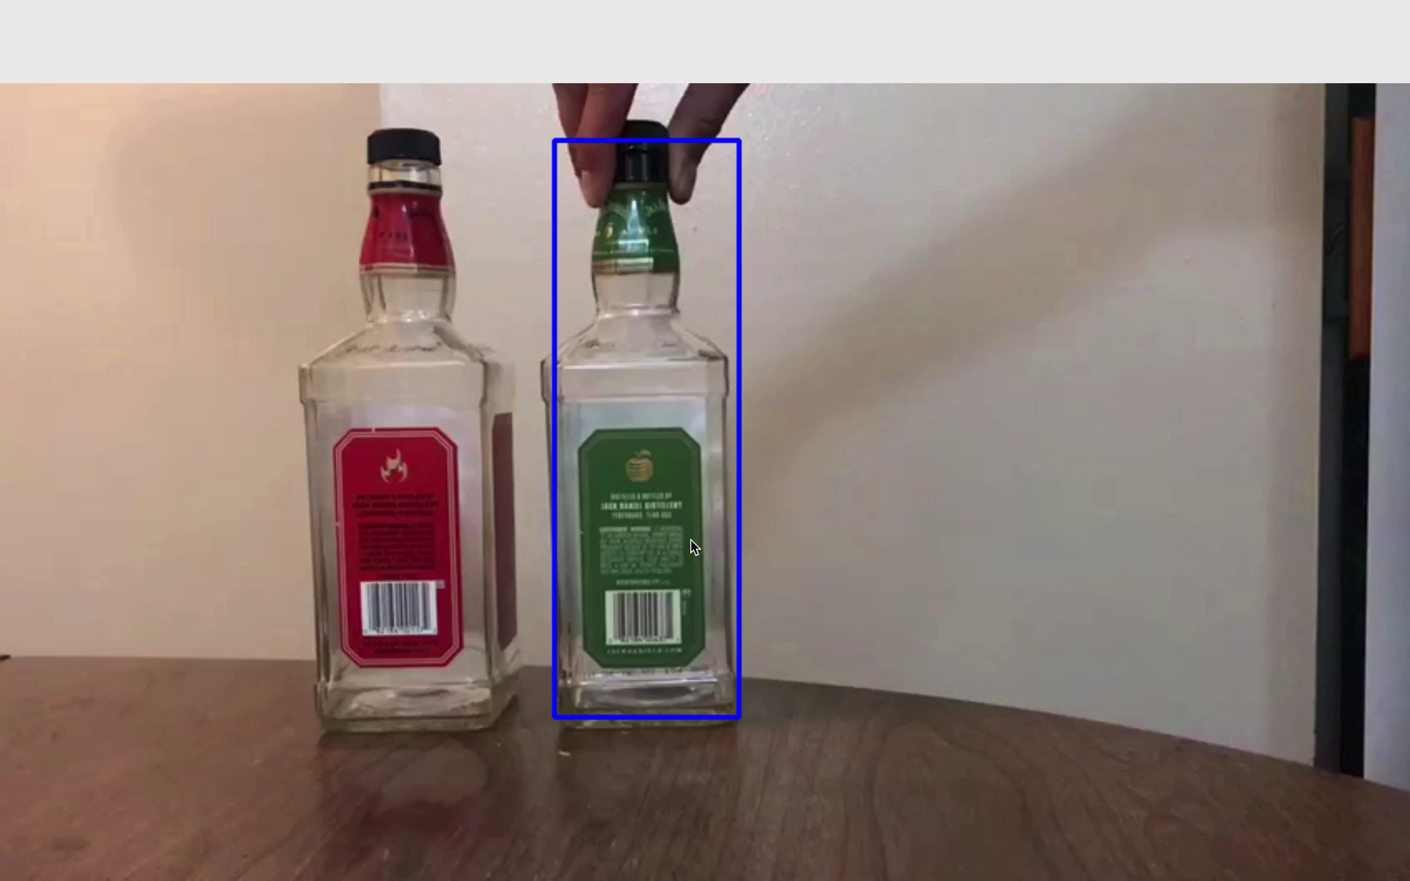
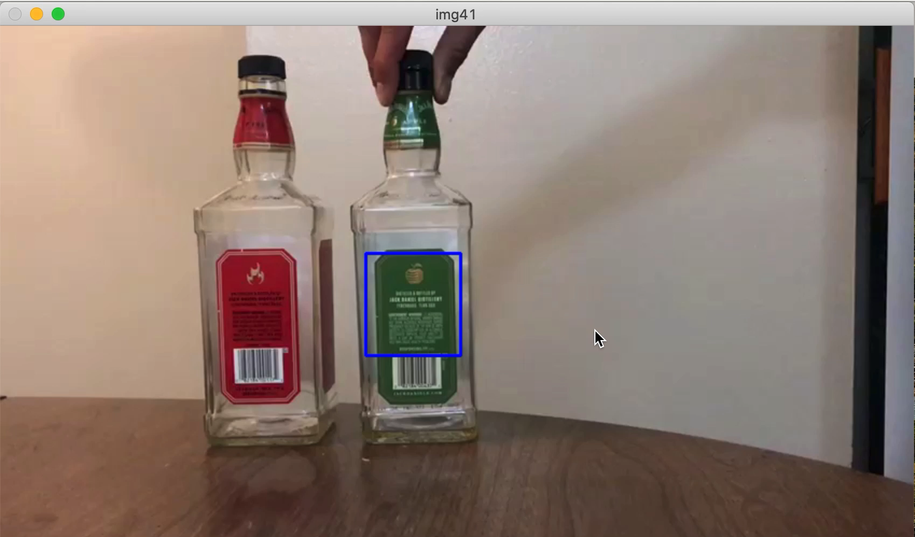
Preliminary Results
Siam-RPN Sample
SiamRPN with Mean-Shift

Slide 6
Future Work
Instead of applying mean shift, we plan to apply feature space engineering on the model.
Involves reducing the dominance of second most dominated object in every frame.

Slide 7
Thank You !!

